Slide 1

Entity Framework
1 – Introduction to EF 5/6

Slide 2
Overview
1 – Overview of EF
2 – Database First Modeling
3 – Coding Data Access
4 – Code First
5 – Model First
6 – Enterprise Considerations
7 – Bounded Contexts in Code First
8 – Repositories and Units of Work
9 – Injection and Testing

Slide 3
What is EF?
Microsoft’s ORM
Focus on data through object model instead of db constructs
Write a lot less data access code
Microsoft’s Object/Relational Mapper
Product goals
Make .NET & Windows Azure the best platform for data centered apps
Be the most productive data access API
LINQ against disparate relational databases
Recommended technology to connect .NET applications to databases

Slide 4
ORM Frameworks in .NET
Built-in ORM tools in .NET Framework and VS
ADO.NET Entity Framework
LINQ to SQL
Both combine entity class mappings and code generation, SQL is generated at runtime
Third party ORM tools
NHibernate – the old daddy of ORM
Telerik OpenAccess ORM

Slide 5
Entity Framework is also a ORM
Data access framework
Supports data-centric applications and services
Enables programming against a conceptual application model
Enables independency of any data storage engine or relational schema

Slide 6
ORM Advantages
Object-relational mapping advantages
Developer productivity
Writing less code
Abstract from differences between object and relational world
Complexity hidden within ORM
Manageability of the CRUD operations for complex relationships
Easier maintainability

Slide 7
Programming Against a Model
EF uses a model called an Entity Data Model (EDM)
EDM is a client-side data model
EDM is an abstraction layer on top of the data storage
Remove the pain of
Interacting with the data storage
Translating the data into objects

Slide 8
Entity Framework in a Nutshell
Goal: Simple and seamless data access for the .NET platform
Better layering
Better re-use of existing knowledge and assets
EDM – Entity Data Model
An abstract model for defining entities and relationships
Includes schema and mapping
Store Schema Definition (SSDL)
Conceptual Schema Definition (CSDL)
Mapping Schema between the two (MSL)
Entity Framework
An implementation of EDM and an ORM layer on top
A framework for using entities over data

Slide 9
Data Store
The Entity Framework has no knowledge of the database that stores the data
It connects and interacts with the database through a provider that is usually declared in the configuration file
As in ADO.NET the providers are supplied by the dbms vendors
Some supported dbms’es:
SQLServer ;-)
Oracle
MySQL
postgreSQL
db2
...

Slide 10


Getting Started
Database First (VS 2008 and .NET 3.5 SP1)
why? it already exists, or you want low level control over the database
DB
Model
Design time
Design time
Code
Model First (VS 2010 and .NET 4.0)
why? you want separation from code and database in a declarative format
DB
Model
Design time
Design time
Code
Code First (Entity Framework Feature CTP3)
why? primarily focused on code shape, database is an implementation detail
DB
Model
Runtime
Runtime
Code

Slide 11
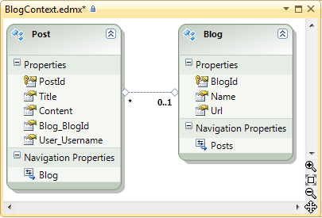
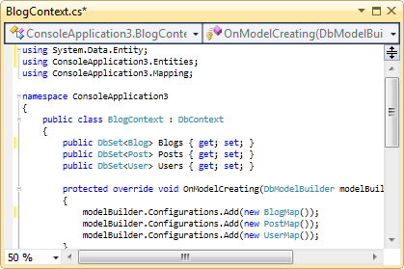
Developer Workflows
Designer-centric
Code-centric
New database
Model first
Create .edmx model in designer
Generate database from .edmx
Classes auto-generated from .edmx
Code first
Define classes and mapping in code
Database auto-created at runtime
Existing database
Database first
Reverse engineer into .edmx model
Classes auto-generated from .edmx
Code first
Reverse engineer into code model
Requires EF PowerTools download

Slide 12
How to get it
EF NuGet Package
EF Core bits in .NET
DbContext, Code First & Migrations
EF Designer in VS
Updated in .NET 4.5
Included in VS 2012
Updated in VS 2012
Works with .NET 4.0 & 4.5, VS 2010 & 2012
New features like Enums, Spatial, better performance, etc.
New features like multiple diagrams, colorization, DbContext code generation, etc.

Slide 13
Versions
Entity Framework 7
Runtime out-of-band (NuGet)
Tooling out-of-band (Microsoft Download Center)
Latest version “chained in” to new Visual Studio releases
Entity Framework 6.1.2
Entity Framework 6 -> 6.1.1
Entity Framework 5
Core runtime in .NET Framework
Newer runtime pieces out-of-band (NuGet)
Tooling in Visual Studio
Entity Framework 4.1 -> 4.3
Entity Framework 4
Runtime in .NET Framework
Tooling in Visual Studio
Entity Framework 3.5 SP1

Slide 14
EF5 Features
Both for code-centric and designer-centric developers
Enum support
Spatial data types
Only for designer-centric developers
Table-valued Functions (TVFs)
Multiple diagrams and coloring
Batch import of stored procedures
DbContext code generation
Auto-compiled query
Parameter evaluation performance

Slide 15

NEW IN EF6
Async query and save
Dependency injection pattern
Code first custom conventions
Enums, spatial, etc. on .NET 4.0
Connection resiliency (retry)
Tooling consolidation
Code first stored procedure support

Slide 16
EF6 Features
Open source
Code First & EF Designer
Asynchronous query and save
Connection resiliency
Code-based configuration
Database command interception/logging
Performance improvements
Code First Only
Custom conventions
Insert, update, & delete stored procedures

Slide 17
EF6 Features
From the EF team
Nested entity types
Improved transaction Support
Multiple contexts per database
DbModelBuilder.HasDefaultSchema
Configurable migrations history table
Creating context with an open connection
Enums, spatial and better performance on .NET 4.0
Default transaction isolation level changed to READ_COMMITTED_SNAPSHOT

Slide 18
EF6 Features
From our contributors
Custom migrations operations
Improved warm up time for large models
Pluggable pluralization & singularization service
DbModelBuilder.Configurations.AddFromAssembly
DbSet.AddRange/RemoveRange

Slide 19
Approaches to ORM
Template-based code generation vs. entity classes mappings
SQL generation (design time / runtime) vs. mapping existing SQL
Entity classes representation
Entities are just POCO (Plain Old C# Objects)
Entities implement special IPersistent interface or extend PersistentBase class
Configuring mappings
DB schema data vs. XML vs. annotations

Slide 20
Entity Framework Features
Entity Framework standard features:
Map tables, views, stored procedures and functions as objects
Provides LINQ-bases data queries
Executed as SQL SELECTs on the Database server
CRUD operations – Create/Read/Update/Delete
Create compiled queries – for executing the same parameterized query multiple times
Creating or deleting the database schema

Slide 21
Entity Framework Lifecycle (2)
When the database returns the results
Entity Framework translates them back to objects
The Database is transparent, hidden behind the API
LINQ is executed over IQueryable<T>
At compile time a query expression tree is emitted
At runtime SQL is generated and executed

Slide 22
LINQ Components
The ObjectContext class
ObjectContext holds the connection to the database and the entity classes
Provides LINQ-based data access
Implements identity tracking, change tracking, and API for CRUD operations
Entity classes
Each database table is typically mapped to a single entity class

Slide 23
LINQ Components (2)
Associations
An association is a primary key / foreign key based relationship between two entity classes
Allows navigation from one entity to another, e.g. Student.Courses
Concurrency control
Entity Framework uses optimistic concurrency control
Provides automatic concurrency conflict detection and means for conflicts resolution

Slide 24
LINQ to Entity Files
Visual Studio has built-in EF data designer and code generator
Mappings are stored in .edmx files (Entity Data Model XML)
<database>.edmx is an XML file
Holds a connection string and metadata representing the database schema
<database>.cs file contains the entity classes and the ObjectContext class
One entity class for each mapped database table

Slide 25
Logging the Native Queries
To print the native Database SQL queries call the cast the object to ObjectQuery and call the method ToTraceString();
var p = CountriesEntities.Countries;
Console.WriteLine((query as ObjectQuery).ToTraceString());
This will print the queries executed to select the Countries
Can be printed to file using StreamWriter class instead of Console class

Slide 26
Creating New Data
To create a new row use the method AddObject(…) of the corresponding collection
// Create new order object
Order order = new Order()
{
OrderDate = DateTime.Now, ShipName = "Titanic",
ShippedDate = new DateTime(1912, 4, 15),
ShipCity = "Bottom Of The Ocean"
};
// Mark the object for inserting
context.Orders.AddObject(order);
context.SaveChanges();
This will execute an SQL INSERT
SaveChanges() method call is required to perform the insert actions

Slide 27
Creating New Data (2)
Creating new row can also be done by using the AddTo+The_Entity_Name method directly on the ObjectContext
This method is depricated
Better use the other one
// Mark the object for inserting
context.AddToOrders(order);
context.SaveChanges();

Slide 28
Creating New Data with Cascading
We can also add data cascading in the database:
Country spain = new Country();
spain.Name = "Spain";
spain.Population = "46 030 10";
spain.Cities.Add( new City { Name = "Barcelona"} );
spain.Cities.Add( new City { Name = "Madrid"} );
countryEntities.Countries.AddObject(spain);
countryEntities.SaveChanges();
This way we don't have to add each City individually
They will be added when the Country Entity (spain) is inserted in the database

Slide 29
Reading Data with LINQ
Reading data from EF entity:
Customers property in the ObjectContext:
NorthwindEntities northwindEntities=
new NorthwindEntities();
var customers =
from c in context.Customers
where c.City == "London"
select c;
Transformed to SQL and is executed at the sever
public ObjectSet<Customer> Customers
{ get{
if ((_Customers == null))
{ _Customers
=base.CreateObjectSet<Customer>("Customers");
}
return _Customers;
}
}

Slide 30
Updating Data
ObjectContext allows modifying object properties and persisting them in the Database
Just load an entity, modify it and call SaveChanges()
The ObjectContext automatically tracks all changes made on its entity objects
Order order = northwindEntities.Orders.First();
order.OrderDate = DateTime.Now;
context.SaveChanges();
This will execute an SQL UPDATE
This will execute an SQL SELECT to load the first order

Slide 31
Deleting Data
Delete is done by DeleteObject() on the current entity collection
SaveChanges() method performs the delete action
Order order = northwindEntities.Orders.First();
// Mark the entity for deleting on the next save
northwindEntities.Orders.DeleteObject(order);
northwindEntities.SaveChanges();
This will execute an SQL DELETE

Slide 32
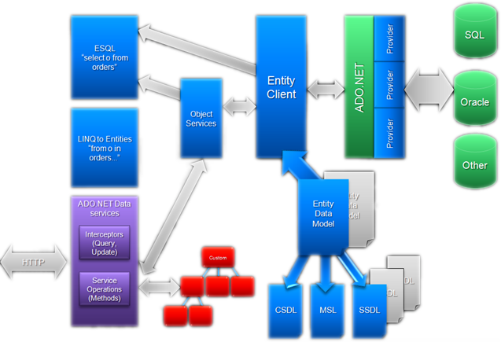
ADO.NET Entity Framework Architecture

Slide 33
Links
These links and more - bit.ly/EFdotnetConf (case sensitive)
Team blog – blogs.msdn.com/adonet
Documentation – msdn.com/data/ef
EF6 Project – EntityFramework.codeplex.com
EF7 Project – github.com/aspnet/EntityFramework
Twitter – @efmagicunicorns
Facebook – facebook.com/efmagicunicorns

Slide 34
Advanced concepts
Enums
Complex Types
M:N relationships
Proxies and Lazy Loading

Slide 35
OTHER CONSIDERATIONS…
Transactions
Unit testing
Service boundaries
Concurrency
Entity mapping strategies

Slide 36
OO vs Relational
OO | Relational
Objects | Sets
Unidirectional Associations | Bidirectional Associations
Pointer from owner | Foreign Keys
Inheritance | None
Polymorhpism | None
M:M | Join Tables

Slide 37
The Course
EF 5.0 / 6.0
SQL Server 2014 Express Assumed installed
Adventureworks DB
And other sample databases

Slide 38
Demo
Create an entity data model from a database
Query the model

Slide 39
Summary

